Slide 1

SKATEBOARDING
”Skateboarding is an art form, a lifestyle, and a sport”- Tony Hawk

Slide 2
Components of a skateboard
Griptape
Deck
Hardware
Trucks
Wheels
Bearings
Risers

Slide 3
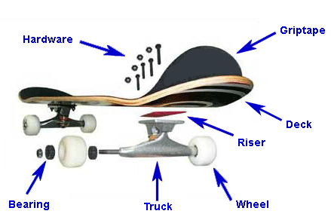

Slide 4
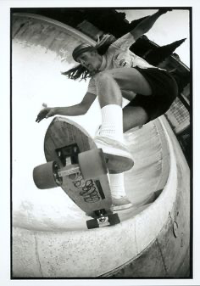
History
Skateboarding fist appeared in California in the 1950’s
Early skateboards were homemade, wood slabs with metal roller skate wheels
Skateboarding became popular in the 60’s with downhill, freestyle and Slalome competitions
1995 ESPN holds its first Xgames
2000s skateboarding goes mainstream and large company’s start to sponsor professional skateboarders

Slide 5
Skateboarding influence
Music
Art
Community
Mainstream companies
Fashion

Slide 6
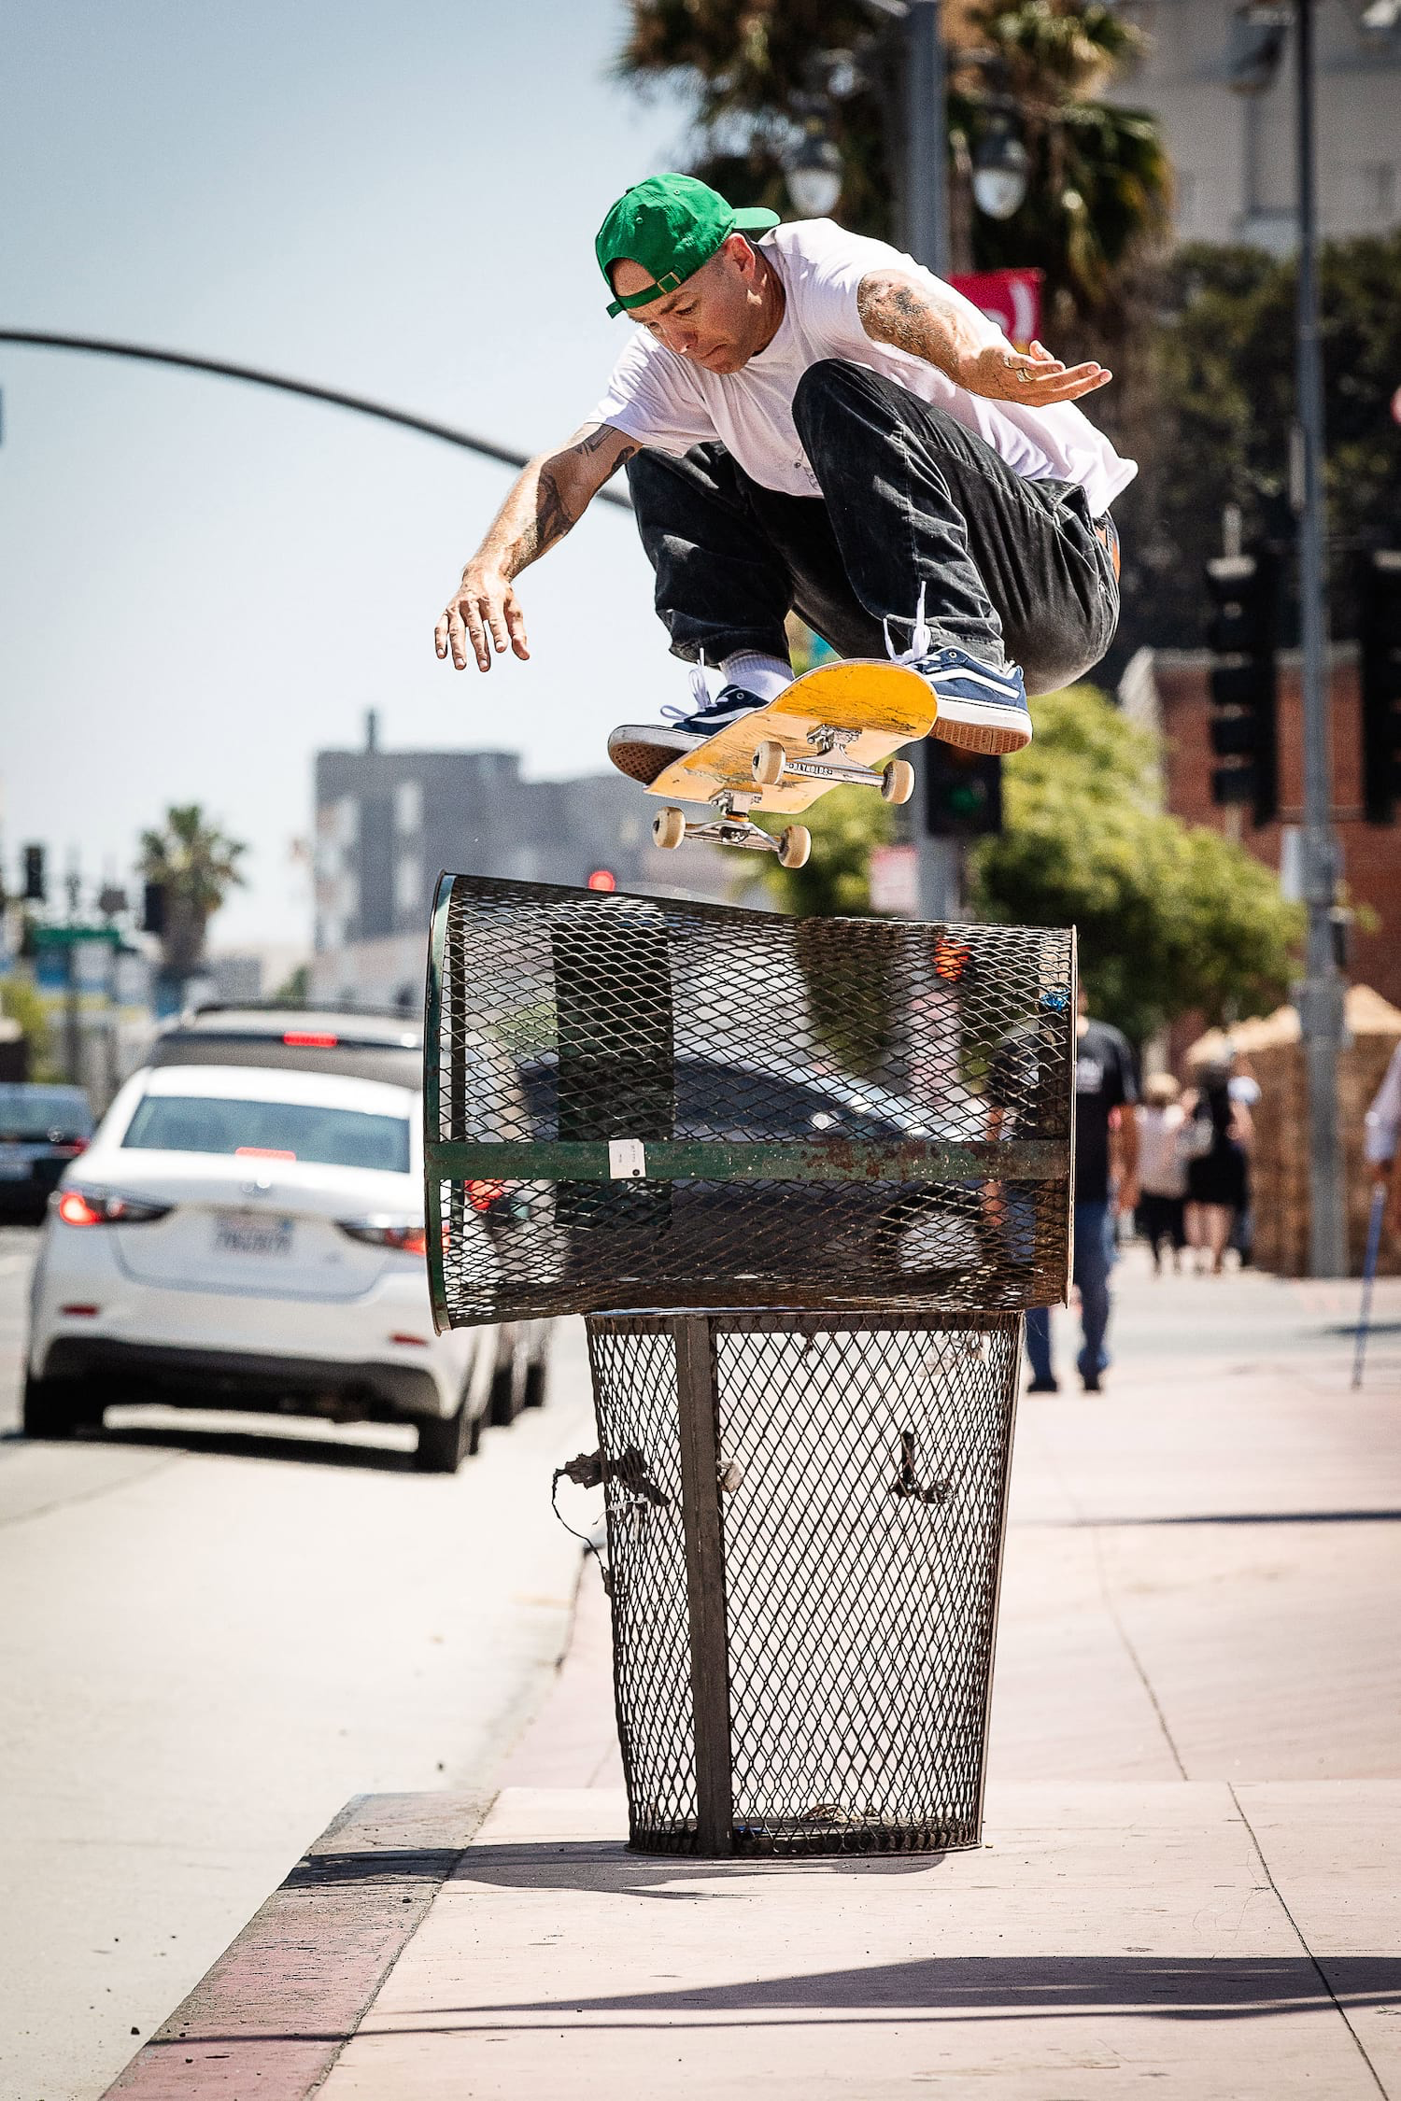
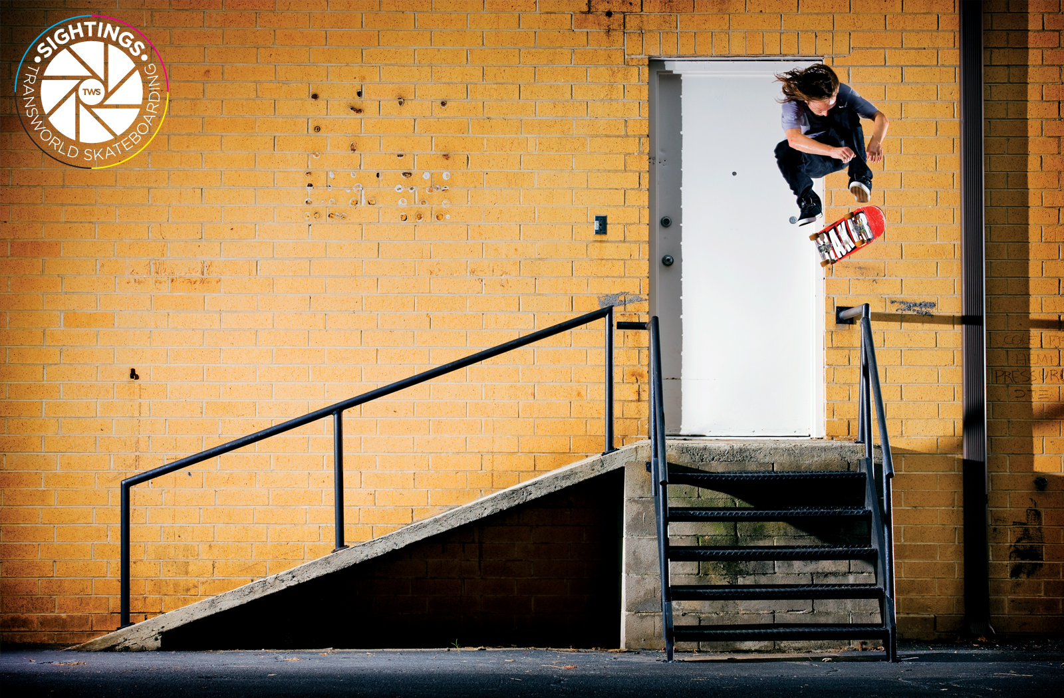
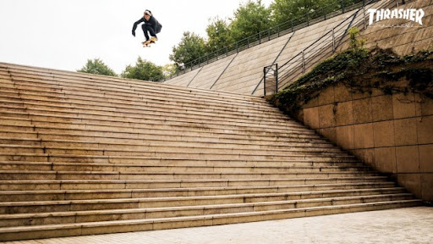
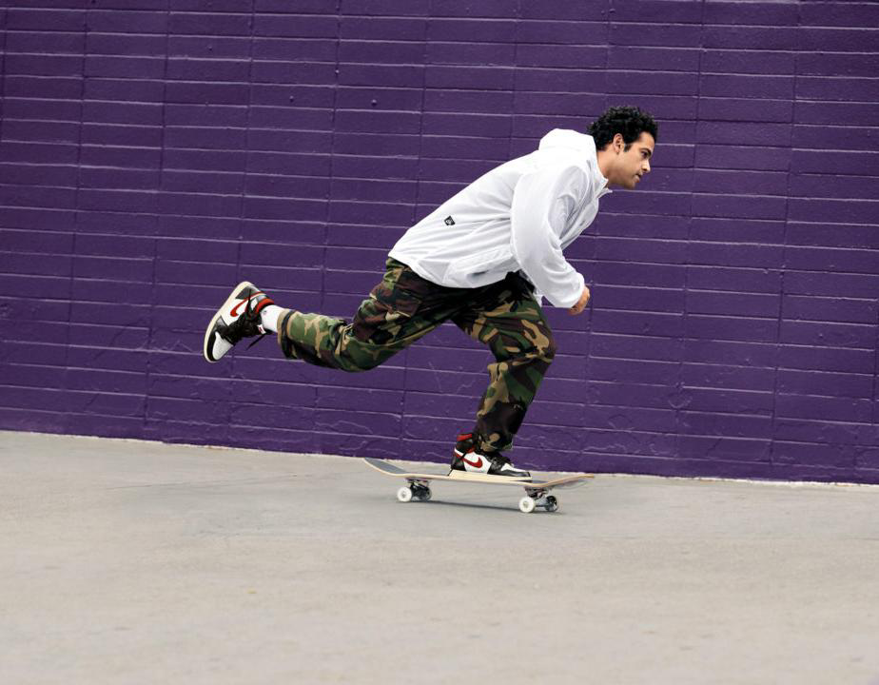
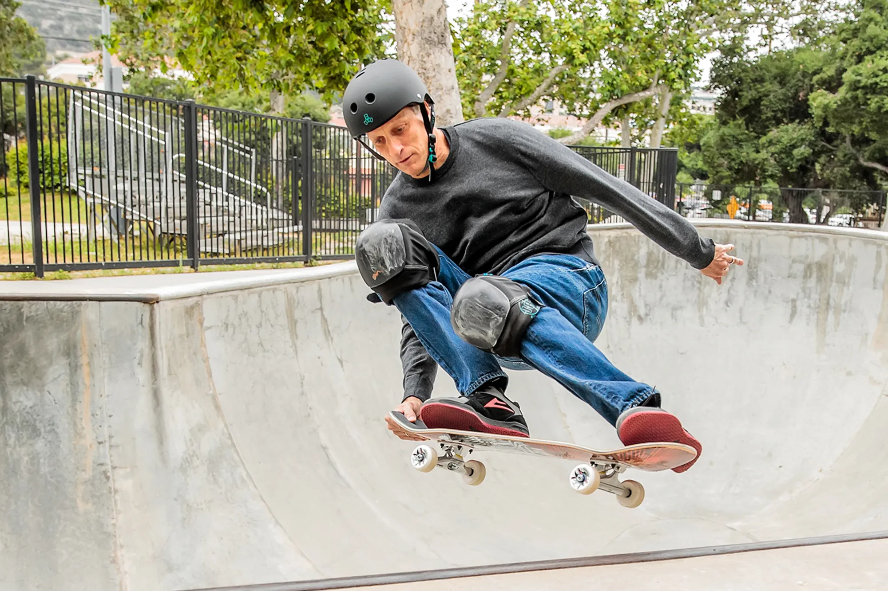
Favorite skateboarders
Bryan Herman
Andrew Reynolds
Tony hawk
Paul Rodriguez
Aaron Hamoki

Slide 7
Skateboard injuries compared to other popular sports 2013-2018
Common misconception is that skateboarding is more dangerous than common ball sports!

Slide 8
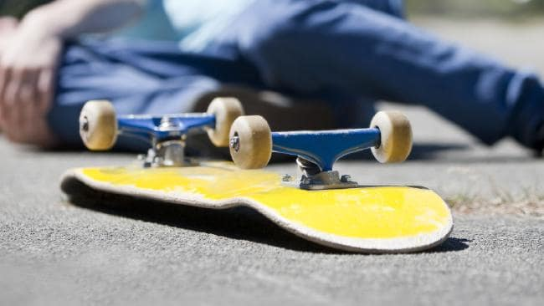
Different types of skateboard injuries
Concussion
Broken wrist
Ankle injuries
Face injuries
Long bone fractures

Slide 9
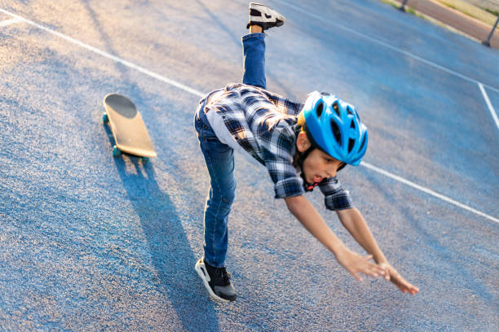
10 important skateboarding preventative measures for injuries
1. helmet!
2. Pads!
3. practice, practice, practice!
4. Never try anything you're not ready for!
5. Learn to fall safely!
6. Don’t skate in the rain or when wet!
7. stretch!
8. Skate in a safe environment!
9. Drink lots of water!
10. Have fun!

